Slide 1
CS 736: Advanced Operating Systems Andrea Arpaci-Dusseau Lecture 5: Optimizing Graph Computation for Storage
Questions for Today:
How can one restructure computation to be more SSD friendly?
To do for Thursday
Read paper and answer question for next lecture: FlashGraph and WiscKey (focus)
Week 3 Reading Group – Canvas
Mini-Project made available after lecture…

Slide 2
Why These Papers?
Recent work by systems community
Systems is more than Operating Systems
Solving an end-to-end problem
New design (or combination), implementation, evaluation
Graph computations of great interest: requires systems innovations too
Always important to optimize single-node performance
Good examples of optimizing for storage characteristics
Opportunity to compare/contrast 2 papers
What is similar?
What is different?

Slide 4
X-Stream: Edge-Centric Graph Processing using Streaming Partitions
Amitabha Roy
Ivo Mihailovic
Willy Zwaenepoel

Slide 5
Problem Motivation?

Slide 13




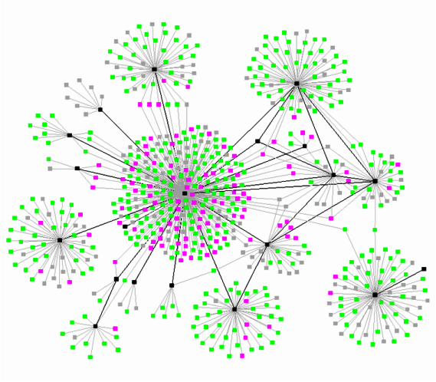
Graphs
Interesting information is encoded as graphs
HyperANF
Pagerank
ALS
….
+

Slide 14
Big Graphs
Large graphs are a subset of the big data problem
Billions of vertices and edges, hundreds of gigabytes
Normally tackled on large clusters
Pregel, Giraph, Graphlab …
Complexity, Power consumption …
Can we do large graphs on a single machine ?

Slide 15
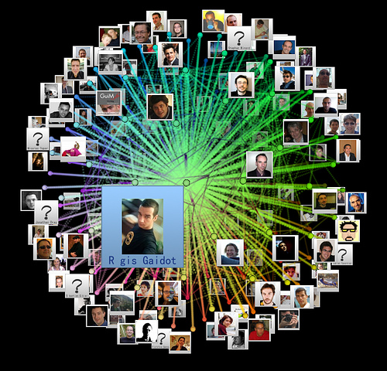
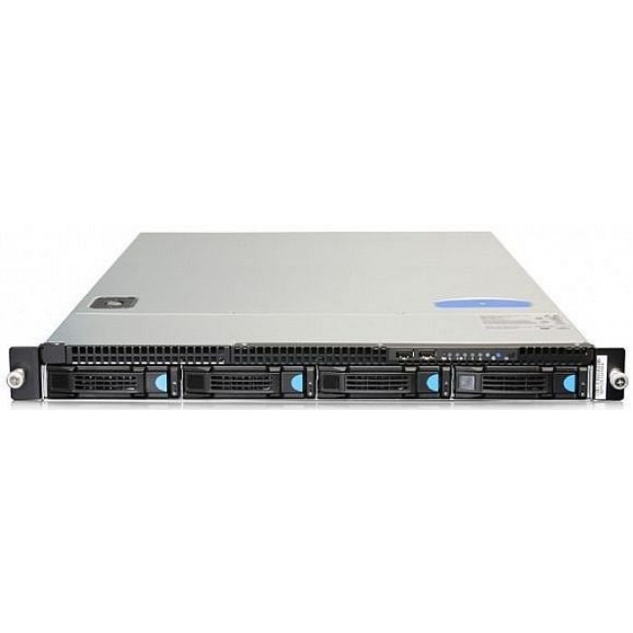
X-Stream
Process large graphs on a single machine
1U server = 64 GB RAM + 2 x 200 GB SSD + 3 x 3TB drive
Notes:
Throw away why build X-Stream.

Slide 16
Problem Motivation
Same motivation across both systems/papers
Later papers often have an easier time with motivation

Slide 17
Computational Model?

Slide 20
Notes:
？？？ 异步！

Slide 21
Standard Scatter Gather
State stored in vertices
Vertex operations
Scatter updates along outgoing edges
Gather updates from incoming edges
V
V
Scatter
Gather
Notes:
Need a picture for scatter gather.

Slide 22
Standard Scatter Gather
1
6
3
7
2
5
8
4
BFS
Notes:
Green should not be sharp.

Slide 23
Vertex-Centric Scatter Gather
Iterates over vertices
for each vertex v
if v has update
for each edge e from v
scatter update along e
Scatter
Standard scatter gather is vertex-centric
Does not work well with storage

Slide 24
Challenge Identified?

Slide 27
Approach
Problem: Graph traversal = random access
Random access is inefficient for storage
Disk (500X slower)
SSD (20X slower)
RAM (2X slower)
Solution: X-Stream makes graph accesses sequential
Any thoughts here?
Notes:
Move first point to previous slide. Consider uncovering points. Add backup slide on bandwidth numbers.

Slide 28
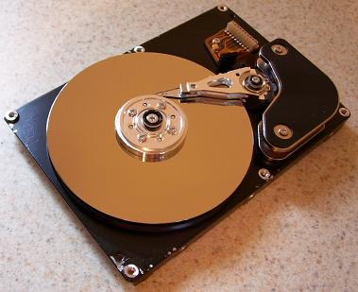
Vertex-Centric Scatter Gather
SOURCE | DEST
1 | 3
1 | 5
2 | 7
2 | 4
3 | 2
3 | 8
4 | 3
4 | 7
4 | 8
5 | 6
6 | 1
8 | 5
8 | 6
Lookup Index
1
6
3
V
1
2
3
4
5
6
7
8
7
2
5
8
4
BFS

Slide 29
Solutions?

Slide 41
Notes:
P 个 intervals， P次load， 每次load需要读P个shard(读P次)，所以一共需要P^2次read。

Slide 42
Any cases where fitting in memory is a problem?
Notes:
Balance size of shards, but some vertices may have much larger out-degrees than others; won’t be able to fit full subgraph (with edges) in memory; divide intervals into sub-intervals

Slide 43
Notes:
需要P^2次读，也需要P^2次写。

Slide 47
Contributions
Edge-centric scatter gather model
Streaming partitions
Notes:
Too much stuff. Headings are too general.

Slide 48
Transformation
for each vertex v
if v has update
for each edge e from v
scatter update along e
for each edge e
If e.src has update
scatter update along e
Scatter
Scatter
Vertex-Centric
Edge-Centric

Slide 49
Edge-Centric Scatter Gather
SOURCE | DEST
1 | 3
1 | 5
2 | 7
2 | 4
3 | 2
3 | 8
4 | 3
4 | 7
4 | 8
5 | 6
6 | 1
8 | 5
8 | 6
1
6
3
V
1
2
3
4
5
6
7
8
7
2
5
8
4
BFS

Slide 50
SOURCE | DEST
1 | 3
1 | 5
2 | 7
2 | 4
3 | 2
3 | 8
4 | 3
4 | 7
4 | 8
5 | 6
6 | 1
8 | 5
8 | 6
SOURCE | DEST
1 | 3
8 | 6
5 | 6
2 | 4
3 | 2
4 | 7
4 | 3
3 | 8
4 | 8
2 | 7
6 | 1
8 | 5
1 | 5
=
No index
No clustering
No sorting

Slide 51
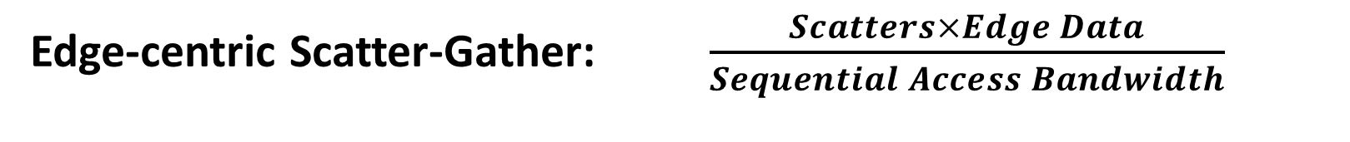

Tradeoff
Vertex-centric Scatter-Gather: $\frac{Edge Data}{Random Access Bandwidth}$
Edge-centric Scatter-Gather: $\frac{Scatters×Edge Data}{Sequential Access Bandwidth}$
Sequential Access Bandwidth >> Random Access Bandwidth
Few scatter gather iterations for real world graphs
Well connected, variety of datasets covered in the paper

Slide 52
What type of graphs perform well? Or poorly?
1
6
8
1
3
D=7, BFS in 7 steps
7
2
2
7
5
8
4
6
3
4
5
D=3, BFS in 3 steps, Most real-world graphs
Real world graphs have low diameter

Slide 53
Contributions
Edge-centric scatter gather model
Streaming partitions
Notes:
Too much stuff. Headings are too general.

Slide 54
Streaming Partitions
Problem: still have random access to vertex set
V
1
2
3
4
5
6
7
8
Solution: partition the graph into streaming partitions

Slide 55
Streaming Partitions
A streaming partition is
A subset of the vertices that fits in RAM
All edges whose source vertex is in that subset
No requirement on quality of the partition

Slide 56
Partitioning the Graph
SOURCE | DEST
1 | 5
4 | 7
2 | 7
4 | 3
4 | 8
3 | 8
2 | 4
1 | 3
3 | 2
Subset of vertices
V1
1
2
3
4
V2
5
6
7
8
SOURCE | DEST
5 | 6
8 | 6
8 | 5
6 | 1

Slide 57
Pre-processing Overhead
Low overhead for producing streaming partition
Strictly cheaper than sorting edges by source vertex
Notes:
Partition(X-stream) is much cheaper than sort(graphChi)

Slide 58
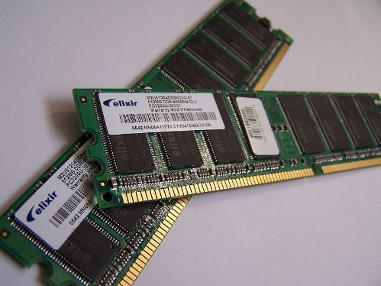
Random Accesses for Free
SOURCE | DEST
1 | 5
4 | 7
2 | 7
4 | 3
4 | 8
3 | 8
2 | 4
1 | 3
3 | 2
V1
1
2
3
4

Slide 59
Generalization
SOURCE | DEST
1 | 5
4 | 7
2 | 7
4 | 3
4 | 8
3 | 8
2 | 4
1 | 3
3 | 2
V1
1
2
3
4
Fast storage
Slow storage
Applies to any two level memory hierarchy

Slide 60
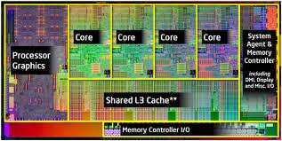

Generally Applicable
RAM
RAM
CPU Cache
OR
OR
Disk
SSD
RAM

Slide 61
Parallelism
Simple Parallelism
State is stored in vertex
Streaming partitions have disjoint vertices
Can process streaming partitions in parallel

Slide 62
Gathering Updates
Partition 1
Edges
Vertices
Partition 100
X
Y
X
Vertices
Y
Shuffler
Minimize random access for large number of partitions
Multi-round copying akin to merge sort but cheaper

Slide 63
How to pick size of streaming partition?
What determines the maximum size of a streaming partition?
All vertices must fit in fast memory for random access
What influences having as large of streaming partition as possible?
Want edge and update lists large to get best sequential behavior
As few streaming partitions as possible

Slide 64
Comparison
Different approaches to meet same goal
Each has portion of graph in memory
Each tries to access edges sequentially
Graphchi uses “shards”
Partitions edges into sorted shards
X-Stream uses sequential scans
Partitions edges into unsorted streaming partitions
Notes:
Consider putting in a table of differences
graphChi is sorted, stream partition is unsorted

Slide 65
Applications?

Slide 67
Applications
X-Stream can solve a variety of problems
BFS, SSSP, Weakly connected components, Strongly connected components, Maximal independent sets, Minimum cost spanning trees, Belief propagation, Alternating least squares, Pagerank, Betweenness centrality, Triangle counting, Approximate neighborhood function, Conductance, K-Cores
Q. Average distance between people on a social network ?
A. Use approximate neighborhood function.
Notes:
Remove.

Slide 68
Evaluation?

Slide 75
X-Stream Main Memory Performance

Slide 76
No Specialized Graph Optimizations (e.g., inverted edge list)

Slide 77
Baseline to Graphchi
Replicated OSDI 2012 experiments on our SSD
Create shards
Run Algorithm
Graphchi
Input
Shards
Answer
X-Stream
Run Algorithm
Input
Answer
Notes:
Consider putting in a table of differences

Slide 78
X-Stream Speedup over Graphchi
Mean Speedup = 2.3

Slide 79
Baseline to Graphchi
Replicated OSDI 2012 experiments on our SSD
Create shards
Run Algorithm
Graphchi
Input
Shards
Answer
X-Stream
Run Algorithm
Input
Answer
Notes:
Consider putting in a table of differences

Slide 80
X-Stream Speedup over Graphchi ( + sharding)
Mean Speedup
Prev = 2.3
Now = 3.7

Slide 81
Preprocessing Impact
Notes:
Put fourth benchmark back in.

Slide 82
Sequential Access Bandwidth
Graphchi shard: What must fit in memory?
All vertices and edges must fit in memory
X-Stream partition: What must fit in memory?
Only vertices must fit in memory
Implication?
More Graphchi shards than X-Stream partitions
Makes access more random for Graphchi
Notes:
graphChi shard(sort, vertice+edges in memory) vs x-stream partition(unsorted, only vertice in memory)

Slide 83
Disk Transfers (Pagerank on Twitter)
Metric | X-Stream | Graphchi
Data moved | 224 GB | 322 GB
Time taken | 398 seconds | 2613 seconds
Transfer rate | 578 MB/s | 126 MB/s
SSD can sustain reads = 667 MB/s, writes = 576 MB/s
X-Stream uses all available bandwidth from the storage device
Notes:
Add a line of explanation.

Slide 84
Scaling up
256 Million V, 4 Billion E, 33 mins
4 Billion V, 64 Billion E,
26 hours
8 Million V, 128 Million E, 8 sec
6 TB Disk
16 GB RAM
400 GB SSD

Slide 86
Conclusion
X-Stream
Edge-centric processing
+
Streaming Partitions
=
Sequential Access
Good Performance
RAM, SSD, Disk
Big graphs
Download from http://labos.epfl.ch/xstream
Notes:
Too many words.

Slide 87
CS 736: Advanced Operating Systems Andrea Arpaci-Dusseau Lecture 5: Optimizing Graph Computation for Storage
Questions for Today:
How can one restructure computation to be more SSD friendly?
To do for Thursday
Read paper and answer question for next lecture: FlashGraph and WiscKey (focus)
Week 3 Reading Group – Canvas
Mini-Project made available after lecture…

Slide 88
X-stream: 另一种distributed system??

